Slide 1
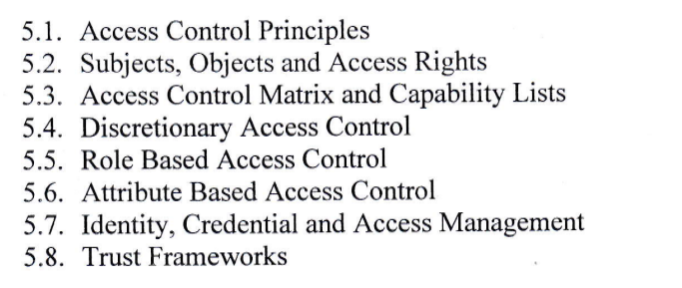
Unit 5 Access Control

Slide 2

Access Control
Access control is a method of restricting access to sensitive data. Only those that have had their identity verified can access company data through an access control gateway.

Slide 3
Components of Access Control
Authentication : The act of proving an assertion, such as the identity of a person or computer user.
Authorization : The function of specifying access rights or privileges to resources.
Access : Once authenticated and authorized, the person or computer can access the resource.
Manage : Managing an access control system includes adding and removing authentication and authorization of users or systems.
Audit : Frequently used as part of access control to enforce the principle of least privilege.

Slide 4
How does Access Control work?
Access control can be split into two groups designed to improve physical security or cybersecurity
Physical Access Control: limits access to campuses, building and other physical assets, e.g. a proximity card to unlock a door.
Logical Access Control: limits access to computers, networks, files and other sensitive data e.g. a username and password.

Slide 5
Why is Access Control Important?
Access control minimizes the risk of authorized access to physical and computer systems, forming a foundational part of information security, data security and network security.

Slide 6
Types of Access Control
Attribute based access control
Discretionary access control
Mandatory access control
Role based access control
Rule based access control
Break-Glass access control

Slide 7
5.1 Access Control Principles
Principle of Least Privilege
Separation of Duties
Need-to-know
Authentication
Authorization
Accountability

Slide 8
5.1 Access Control Principles
Principle of Least Privilege: This principle states that users should only be given the minimum level of access necessary to perform their job functions. This reduces the risk of unauthorized access or misuse of sensitive information.
Separation of Duties: This principle involves dividing responsibilities among different individuals or roles to prevent any one person from having too much control over sensitive information or resources. For example, a system administrator might have the ability to create user accounts, but they should not be able to approve or authorize financial transactions.

Slide 9
5.1 Access Control Principles
Need-to-Know: This principle dictates that users should only be given access to information or resources that they need to perform their job functions. This helps to limit the amount of sensitive information that is available to potential attackers.
Authentication: This principle involves verifying the identity of users before granting access to sensitive information or resources. This can include passwords, biometric data, or other forms of identification.

Slide 10
5.1 Access Control Principles
Authorization: This principle involves determining which users or processes are allowed to access specific information or resources. This can be accomplished through role-based access control, access control lists, or other methods.
Accountability: This principle involves tracking and monitoring access to sensitive information or resources to ensure that any unauthorized access or misuse can be identified and addressed. This can include logging access attempts, auditing user activity, and implementing security controls such as intrusion detection systems.

Slide 11
5.2 Subjects, Objects and Access Rights
Subjects: Subjects are entities that request access to resources. In the context of information security, subjects can be users, processes, or devices.
Objects: Objects are resources that are being accessed, such as files, folders, databases, networks, or applications.
Access Rights: Access rights are permissions that determine the level of access that subjects have to objects. Access rights can include read, write, execute, create, delete, modify, or control.

Slide 12
5.3 Access Control Matrix and Capability Lists
1. Access Control Matrix :
a model that uses a table to define the access rights of subjects to objects.
The rows of the matrix represent the subjects, and the columns represent the objects.
The cells of the matrix contain the access rights that each subject has to each object.
Access rights can be defined using different methods, such as RBAC (Role-Based Access Control), MAC (Mandatory Access Control), or DAC (Discretionary Access Control).

Slide 13
Access Control Matrix
The access control matrix can be useful for managing access to large numbers of resources, as it allows administrators to quickly view and modify access rights for individual subjects or objects.
However, the access control matrix can become complex and difficult to manage when dealing with large numbers of subjects or objects.

Slide 14
Capability Lists
a model that assigns each subject a list of capabilities or permissions that they can use to access objects.
Each object also has a list of capabilities or permissions associated with it. Subjects can only access objects if they have the appropriate capabilities or permissions associated with it.
Subjects can only access objects if they have the appropriate capabilities or permissions.

Slide 15
Capability Lists
can be useful for managing access to resources in a distributed system, where objects may be spread across multiple servers or networks.
this model allows administrators to define specific capabilities for each subject, which can help to limit the potential damage that can be caused by a compromised account.

Slide 16
5.4 Discretionary Access Control
a security model used in computer systems to control access to resources based on the discretion of the resource owner.
the resource owner has the authority to determine who can access their resources and what level of access they are granted.
In a DAC system, each resource (such as files, folders, or devices) is associated with an access control list (ACL) that specifies the permissions for different users or groups.
The ACL typically includes entries for the resource owner and other users or groups, and each entry defines the permissions allowed for that user or group.

Slide 17
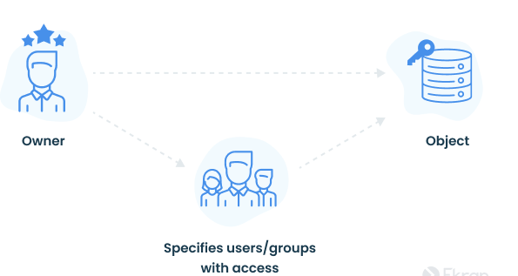
Fig: Discretionary Access Control

Slide 18
What are the basic principles of DAC?
Object characteristics (size, name, directory path) are invisible to users that aren’t authorized.
Several failed access attempts enforce additional multi-factor authentication or deny access.
Users can transfer their object ownership to other users. Also, the owner determines the access type of other users. Based on these access privileges, the operating system decides whether to grant access to a file.

Slide 19
Discretionary Access Control
Gaining access to a file in the DAC model works like this:
User 1 creates a file and becomes its owner, or obtains access rights to an existing file.
User 2 requests access to this file. They provide their credentials: username, password, or something else.
User 1 grants access at their discretion. However, user 1 can’t grant access rights that exceed their own. For example, if user 1 can only read a document, they can’t allow user 2 to edit it.
If there’s no contradiction between the ACL created by an administrator and the decision made by user 1, access is granted.

Slide 20
5.4 Discretionary Access Control
The permissions in a Discretionary Access Control system commonly include:
Read: Allows users to view the contents of a resource.
Write: Enables users to modify or add to the contents of a resource.
Execute: Grants users the ability to execute or run a resource (typically applicable to executable files or scripts).
Delete: Allows users to remove a resource.
Control: Provides users with the ability to modify access control settings for a resource, including permissions and ACL entries.

Slide 21
5.4 Discretionary Access Control
Pros | Cons
User-friendly - Users can manage their data and quickly access data of other users. | Low level of data protection - DAC can’t ensure reliable security because users can share their data however they like.
Flexible - Users can configure data access parameters without administrators. | Obscure access management - There’s no centralized access management, so in order to find out access parameters, you have to check each ACL.
Easy to maintain - Adding new objects and users doesn’t take much time for the administrator. | Overlay of user privileges - A permissions conflict may happen with users of multiple nested workgroups.
Granular - Users can configure access parameters for each piece of data.

Slide 22
5.5 Role based Access Control
a security model used in computer systems to control access to resources based on the roles assigned to users.
In an RBAC system, access control is determined by a user's job function or role within an organization, rather than their individual identity.
each user is assigned one or more roles, and each role is associated with a set of permissions that define the actions the user is authorized to perform.

Slide 23
5.5 Role based Access Control
The RBAC model typically includes three components:
Role Assignment: Users are assigned roles based on their job function or responsibilities within the organization.
Role Permissions: Each role is associated with a set of permissions that define the actions users with that role can perform.
Role Management: Administrators manage the roles and their associated permissions, and can add or remove roles as needed.

Slide 24
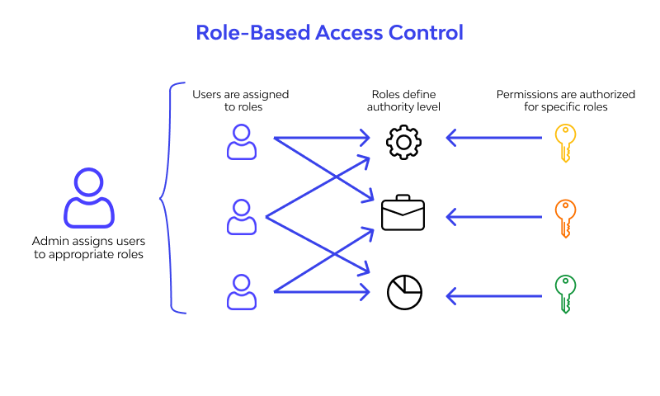

Slide 25
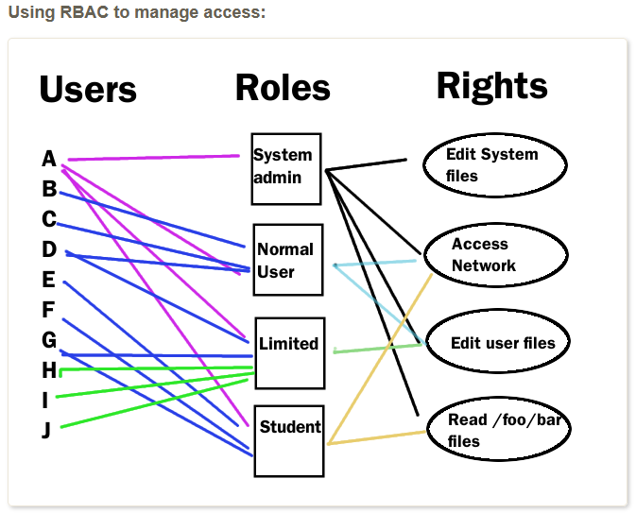

Slide 26
5.5 Role based Access Control
Pros | Cons
Improved Security | Complex Implementation
Simplified Administration | Limited Flexibility
Enhanced Scalability | Role Proliferation
Auditing and Compliance | Initial Setup and Maintenance

Slide 27
5.6 Attribute based Access Control
a security model used in computer systems to control access to resources based on attributes associated with users, resources, and environmental conditions.
access control decisions are made by evaluating the attributes and their values, rather than relying solely on roles or identities.
access control policies are defined based on attributes such as user attributes (e.g., department, job title), resource attributes (e.g., sensitivity level, type), and environmental attributes (e.g., time of day, location).

Slide 28
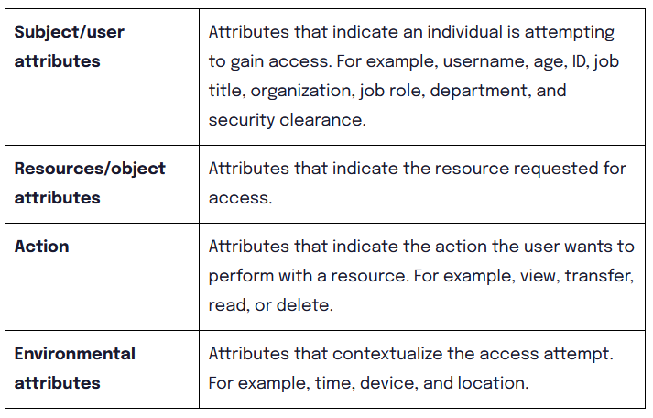
5.6 Attribute based Access Control
Here are the four main categories of attributes:

Slide 29
5.6 Attribute based Access Control
Here is how the process typically works:
An access request is triggered
The ABAC tool scans attributes to determine if they match existing policies.
If the attributes match a policy, the system grants access to the user.

Slide 30
5.6 Attribute based Access Control
Pros | Cons
Fine-Grained Access Control | Complexity
Dynamic and Context-Aware Access Control | Attribute Management
Attribute based Policies | Performance Overhead
Policy Reusability | Scalability

Slide 31
5.6 Identity, Credential and Access Management
a framework that encompasses the processes, technologies, and policies used to manage digital identities, their associated credentials, and the access to resources and services in an organization's information systems.

Slide 32
5.6 Identity, Credential and Access Management
Identity Management
Identity management focuses on the administration and governance of digital identities within an organization.
It involves creating, managing, and maintaining identities for individuals, systems, devices, or entities involved in the organization's ecosystem.
Identity management includes activities such as user provisioning, authentication, password management, and identity lifecycle management.

Slide 33
5.6 Identity, Credential and Access Management
Credential Management
Credential management involves the management of the credentials associated with digital identities.
Credentials are used to verify the identity of individuals or entities and grant them access to resources or services.
Common types of credentials include usernames, passwords, digital certificates, smart cards, and biometric data.
Credential management encompasses processes such as issuing, revoking, and managing the lifecycle of credentials to ensure their integrity and security.

Slide 34
5.6 Identity, Credential and Access Management
Access Management
Access management focuses on controlling and managing the access to resources and services based on the verified identity and authorized privileges of users or entities.
It includes defining access policies, enforcing authentication and authorization mechanisms, and monitoring and auditing access activities.
Access management ensures that users are granted appropriate access rights and privileges based on their roles, responsibilities, and the principle of least privilege.

Slide 35
5.6 Identity, Credential and Access Management
The key components of ICAM typically include:
Identification: The process of uniquely identifying individuals or entities within the system. This involves assigning unique identifiers or usernames to establish their digital identities.
Authentication: Verifying the claimed identity of individuals or entities using various factors, such as passwords, biometrics, smart cards, or multi-factor authentication (MFA). It ensures that only authorized users gain access to resources.
Authorization: Determining the access rights and privileges of authenticated users based on their roles, permissions, and other attributes. This includes defining access control policies and enforcing them to regulate resource access.
Provisioning: Managing the creation, modification, and removal of user accounts and associated access privileges throughout the user lifecycle. This includes onboarding new users, updating user attributes, and deprovisioning users when they no longer require access.
Federation: Establishing trust relationships and interoperability between different systems or organizations to enable the secure sharing of identity information and access across boundaries.

Slide 36
5.7 Trust Frameworks
also known as digital trust frameworks or identity trust frameworks
are sets of rules, policies, and standards that establish the basis for establishing trust and enabling secure digital transactions between different parties in the digital ecosystem.
these frameworks provide a common set of principles and guidelines for managing identity, privacy, and security considerations.
are designed to address the challenges associated with verifying and establishing trust in the digital realm, particularly in contexts such as online authentication, electronic transactions, and the sharing of sensitive information.

Slide 37
5.7 Trust Frameworks
Key components of trust frameworks may include:
Identity Assurance: Trust frameworks often specify the level of assurance or confidence in the identity of individuals or entities involved in digital transactions.
Privacy Protection: Trust frameworks address privacy considerations by outlining rules and practices for the collection, use, and protection of personal information.
Security Standards: Trust frameworks incorporate security requirements and standards to ensure the integrity, confidentiality, and availability of digital transactions.
Interoperability and Interconnectivity: Trust frameworks aim to foster interoperability and enable seamless connectivity between different systems and service providers.
Compliance and Auditing: Trust frameworks often include provisions for compliance monitoring and auditing to ensure that entities adhere to the defined rules and standards.

Slide 38
Assignment
What is access control? Explain about Discretionary and Role based access control.
What is Attribute based access control? Explain about trust framework.
Define access right. Explain access control principles.

